Slide 1

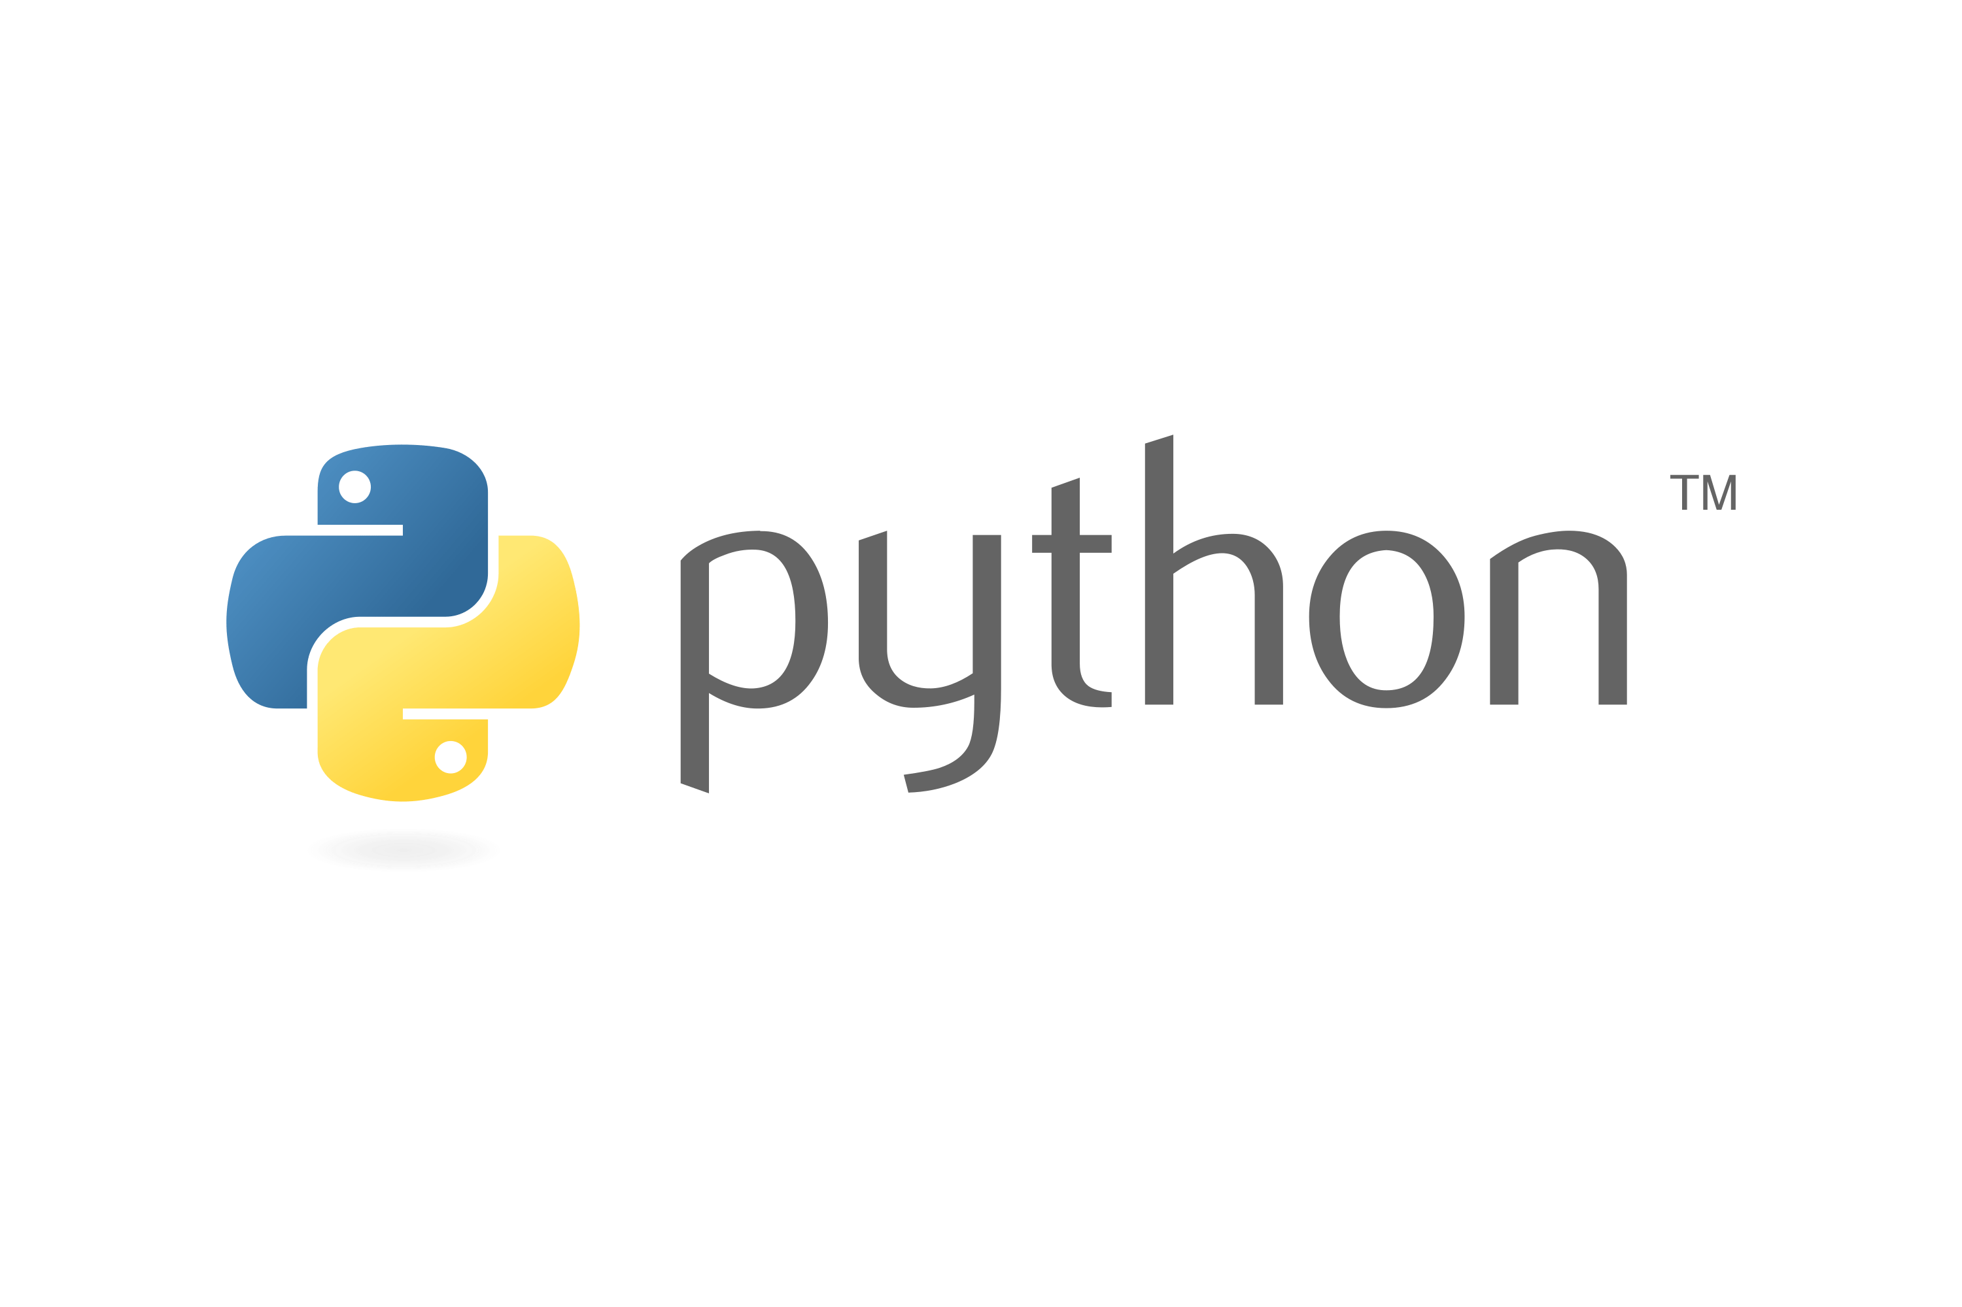
LEARNING PYTHON
20220928

Slide 2

OBJECTIVES
LEARNING PYTHON
INPUT AND OUTPUT
DATA TYPES
OPERATORS

Slide 3
CONTENTS
What is Python
Python Jobs
Why to learn Python?
Python Online Interpreter
One
Two
Google Colab
Python Codes

Slide 4
What is Python
Python is a high-level, object-oriented programming language with built-in data structures and dynamic semantics. It supports multiple programming paradigms, such as structures, object-oriented, and functional programming.
Python supports different modules and packages, which allows program modularity and code reuse.

Slide 5
Python Jobs
Career Opportunities
-Python language provides several job opportunities and promises high growth with huge salary prospects.

Slide 6
Why to learn Python?
Python is a very popular programming language today and often needs an introduction. It is widely used in various business sectors, such as programming, web development, machine learning, and data science. Given its widespread use, it’s not surprising that Python has surpassed Java as the top programming language.
The Top 10 Reasons
Career Opportunities and Salary 6. Libraries and Packages
Data Science 7. Testing Frameworks
Machine Learning 8. Portable and Extensible
Web Development 9. Active Community
Scripting and Automation 10. Easy to Use

Slide 7

Why do we need to learn Python
Often, programmers fall in love with Python because of the increased productivity it provides. Since there is no compilation step, the edit-test-debug cycle is incredibly fast. Debugging Python programs is easy: a bug or bad input will never cause a segmentation fault. Instead, when the interpreter discovers an error, it raises an exception. When the program doesn't catch the exception, the interpreter prints a stack trace. A source level debugger allows inspection of local and global variables, evaluation of arbitrary expressions, setting breakpoints, stepping through the code a line at a time, and so on. The debugger is written in Python itself, testifying to Python's introspective power. On the other hand, often the quickest way to debug a program is to add a few print statements to the source: the fast edit-test-debug cycle makes this simple approach very effective.

Slide 8

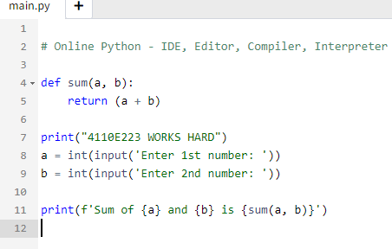
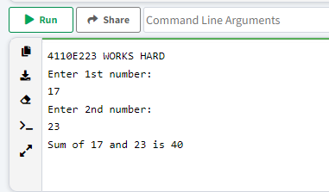
Python Online Interpreter: 1

Slide 9
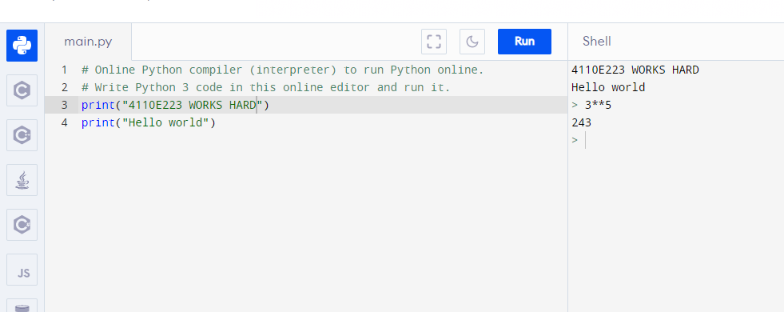
Python OnlineInterpreter: 2
INTERACTIVE

Slide 10
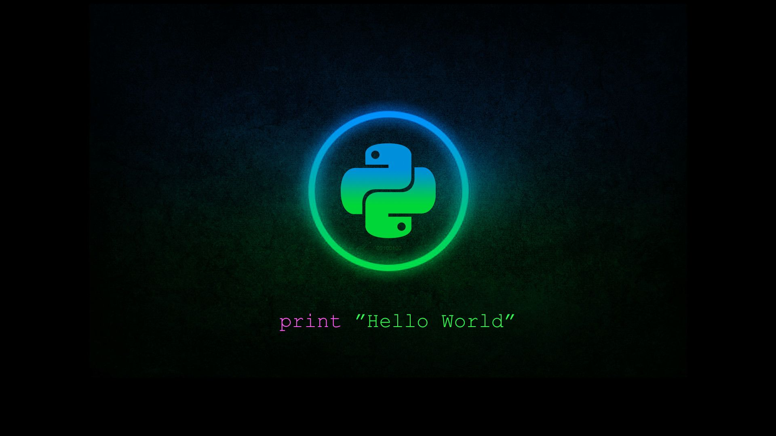
INPUT AND OUTPUT
20220928

Slide 11
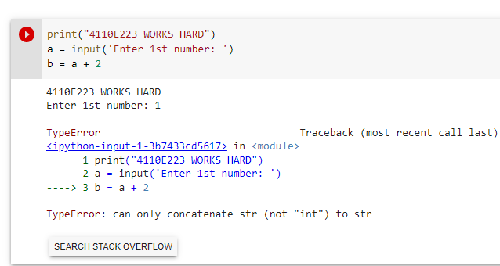
QUESTION:
DATA TYPE

Slide 12
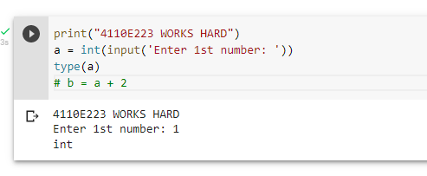
WAY: 1

Slide 13
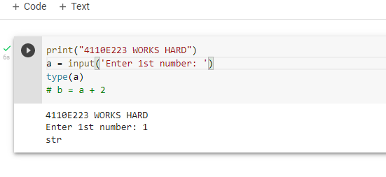
WAY: 2

Slide 14
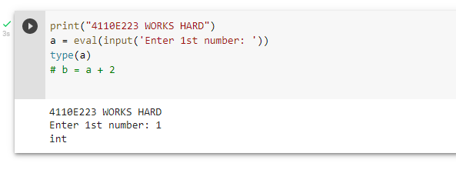
WAY: 3

Slide 15
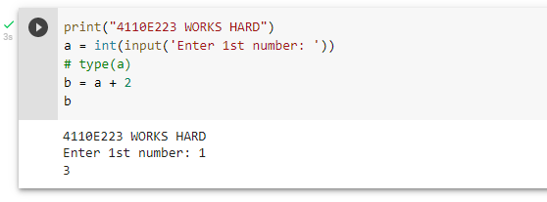
ANSWER: 1

Slide 16
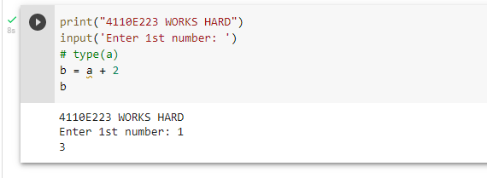
ANSWER: 2

Slide 17
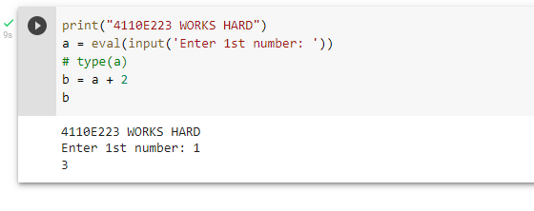
ANSWER: 3

Slide 18
PYTHON DATA TYPES
20220928

Slide 19

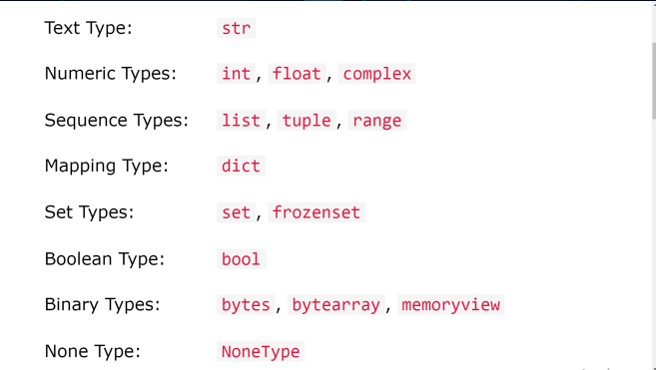
DATA TYPES

Slide 20
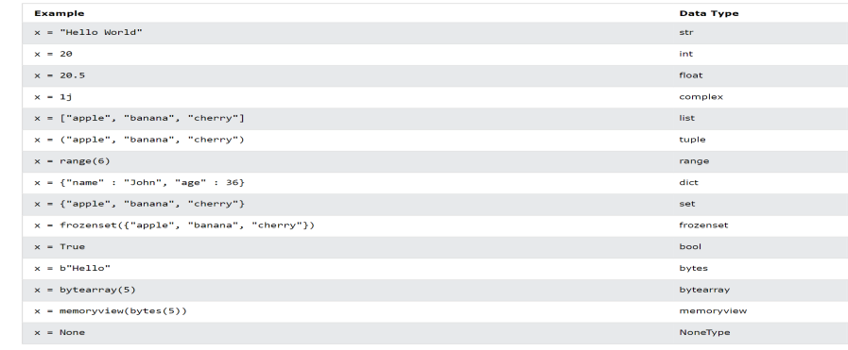
SETTING THE SPECIFIC DATA TYPE

Slide 21
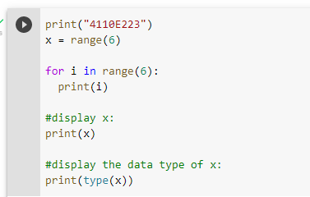
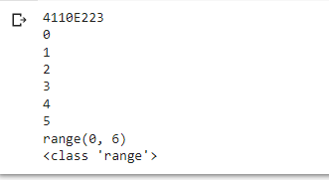

PYTHON DATA

Slide 22
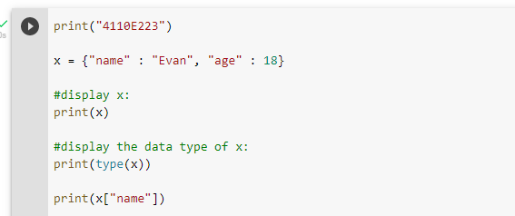

dict: key-value pair

Slide 23
PYTHON OPERATORS
2O0220928

Slide 24
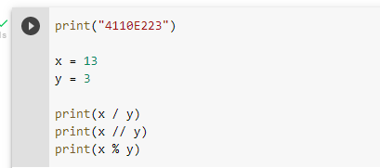

PYTHON ARITHMETIC OPERATORS

Slide 25
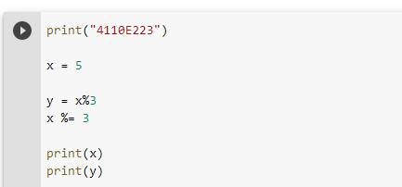

PYTHON ASSIGNMENT OPERATORS

Slide 26
THANK YOU!
CHINESE NAME: 蘇伊凡
STUDENT ID: 4110E223
English Name: Evan S. Marquez
nickname: SuYiFan
email: vnmarqz@gmail.com
GITHUB: https://github.com/Suyifann

Slide 32


